Slide 1

Theoretical Ideas for The Prison Service Digitization - Handheld Concept
By Prison Officer John Saunders
Loading ….

Slide 2







Smith, John
Mobile Hot Page Concept
Clean and modern interface with the ability to interact with all options.
Top section contains details of prisoners name, location, number, IEP status, Age Group and nationality.
AD
MDI – 1-2-032
A1234AA
High Risk Can Share
Enhanced
British
Cleaner
Education RM1
Second sections contains details of AM and PM Labour allocation allowing an officer to know where a prisoner should be throughout the core day.
Third section contains all account details split into the 3 available accounts in an easy to read pie chart.
Next Visit: 17/06/2017
Forth section gives the details of the prisoners next visit and lead visitor.
Lead Visitor: Andrew Smith
Offence Details: Theft from a shop stall
Fifth section gives the details of current offense.
Alerts: Racist, Homophobic, Staff Assaulter
Last section will display any active alerts for the prisoner giving a member of staff indications of potential dangers for instance if the prisoner is a risk to females or assaults staff. If the prisoner is on an open ACCT document the Alerts symbol would display as and orange icon.

Slide 3













Mobile Prison Officer Concept
Theoretical ideas to increase productivity and safety
Safety SOS ability on all devices giving officers location either by Wi-Fi or GPS location and automatic recording and transmission of sound and video once activated. (press and 5 seconds to cancel)
Code Red and Blue would automatically send out location and type of Incident (blue or red) and the give instructions on CPR and how to get someone into the recovery position or how to stop a prisoner from bleeding. By automatically streaming the video to other devises you could potentially stop major disturbances. If other staff can see there is an issue elsewhere in the prison of a large nature then it would be possible to lock up cleaners on another wing to go and assist and get reinforcements in position quicker to stop a situation escalating.
Productivity
Reports
The ability to fill in a report and send it to multiple destinations in different formats for example, when filling out an adjudication you can submit an Information report, Nomis case note entry, a Violence reduction report and send the report to the orderly officer simply by clicking check boxes.
Currently you have to fill in 5 different forms to achieve this which is hugely time consuming.
Private messaging
The ability to quickly message other members of staff in a chat style application to ask questions, confirm prisoners requests and to assure information received is valid.
Google translate The ability to quickly and effectively communicate with Foreign national prisoners that speak little or no English. This would remove frustrations for these individuals and for staff.
QR ID cards, canteen, labour lists and medication could use QR style graphics to create an extra level of security and assurance..

Slide 4




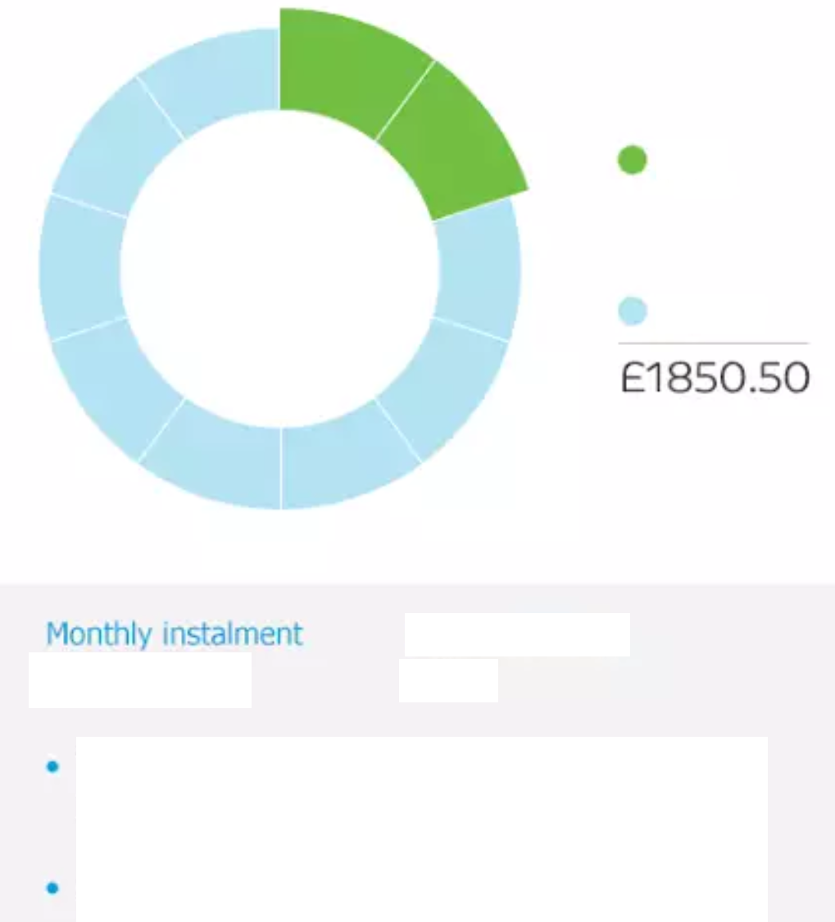
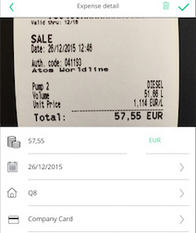

SOP Mobile
Mobile Concept
Theoretical ideas to increase productivity and safety.
Finance
SOP could be integrated to allow for a more useable interface with less options and a crisper feel. This could also introduce some features not available through the traditional use of the system to save the service money.
Upload Receipts
This would allow the User to upload a copy of his or her receipts for parking, meal, food or accommodation to get the balance approved and Potentially save the service money on false claims.
Time Cards
Expenses
Upload Receipts
Log Out
March 2017 Snapshot Statement
24
Approved
Outstanding
60
Statement History
February 2017
Snapshot
This would allow the user to see what overtime had been approved and what was outstanding for the current month and what the expected total of those hours would work out at.
January 2017

Slide 5




AMBER ALERT
Mobile Concept Amber Alert
The amber alert system could be used to find a missing prisoner.
Practical uses would be when a prisoner has been sent to work but not arrived, a member of staff could then issue the Amber Alert and every device in the establishment would receive a notification with the prisoners Name, Number, Picture, Housing Location and Intended Destination.
Once the prisoner is seen for instance in the Gym or at healthcare then the officer or member of staff can reply with the prisoner current location.
If the alert goes unanswered for a set time period then the alert level can be raised and fixed post can be deployed via the system.
This would allow management to keep a track of prisoners and Houseblocks and see who is in areas they shouldn’t be on a regular basis.
It would also encourage staff to take more ownership of their responsibilities for security.
This system would improve security and reliability.
John Smith A1234AA 1-2-023 Education
Alert Activated: 09:20
Time Remaining: 05m:36s

Slide 6


Intelligent and dynamic deployment of Fixed post staff based on location, concentration and proximity of staff to Fixed posed
Knowledge of all staff in prison for orderly officer for incidents, for example C&R advanced, negotiators staff easily contactable
Shareable Workloads and remaining tasks for hand over from outgoing to incoming staff.
NFC Kill switch bracelet for security protection or loss of device, with the ability to stun or brick a device remotely to prevent tampering.
Location and time specific tasks, such as labour lists, roll check and acct checks.
QR tagged ID cards for booking out to labour, education and visits and receiving into workshops, education and visits. The system will then recognise the location of prisoners.
An appointment system that alerts the officer if a prisoner is on the wing and has an appointment to prevent missed appointments and lost productivity.
Digital roll checks so an officer can input a roll as they are counting and another officer can check to say its proved.
Skype or other video services to allow an officer to take part in conferencing for the OM model or to simply be able to take part in an adjudication without having to leave the wing.
Dynamic cell availability and the ability to report them out of order or any fabric issues while on the move allowing all staff wanting to conduct moves from reception, induction, the segregation or from other areas to see what is available and what any current issues are.

Slide 7

Mobile Prison Officer Concept
Cell Availability and Repair Status
In prisons at present there is a high demand for cells population management send prisoners based on the discharges for the day and the currently available cells.
Due to cells being out of order, retention of Foreign national prisoners and other aspects sometimes these numbers do not reflect the true number of cell spaces available.
Occasionally cells are not reported out of use or they are not reported correctly, if the option was there for officers to report on the fly cells that were out of order and their issues it would be possible to have a more accurate representation of a prisons cell availability to receive prisoners or move them around the prison.
This would also speed up the time taken getting cells back online after they have been damaged and increase productivity.
Each cell would be clickable and interactive for either reporting an issue, looking at the current occupants or checking to say an Accommodation fabric check has been done each day.
Notifications will be at the bottom of the screen to identify any existing reported issues.
Houseblock 2 A-Wing
6
7
1’s
2’s
5
8
3’s
4
9
3
10
2
11
1
12
Damaged Cell Out Of Order
Double Cell With Vacancy
Empty Cell
Cell In Use and at Capacity

Slide 8
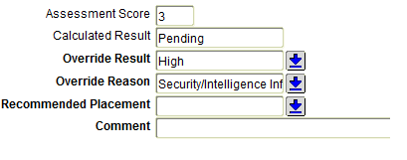
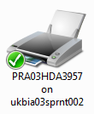
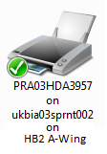
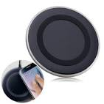
Mobile Prison Officer Concept/Nomis
When receiving a prisoner through reception and conducting the first night procedure it would be useful to have the ability to be able to refer prisoners to other department via the Nomis app to other departments such as Substance misuse, Mental health or OMU.
When inputting a CSRA into Nomis you have the option of 2 outcomes the same as you have on the CSRA form, however when locating prisoners in cell you have 3 potential CSRA risks to take into account: Standard, High risk can share and High risk single cell. This also displays on Nomis as rather standard or high risk but this makes locating a prisoner difficult if they are High risk because at a glance you do not know which one.
If a third option was introduced it would save time having to check through a detailed risk assessment to see if the prisoner can share or not.
Compulsory comments on high risk, risk assessments would be a good idea because on numerous occasions when a risk assessment is entered Nomis will just display as high without any description as to why. Adding compulsory comments to a high risk assessment would increase productivity, data assurance and the reliability of the information a member of staff is presented with.
Cloud based printing for mobile devices and the ability to Name printer shortcuts so instead of printer 3957 you would have Houseblock 2 A-Wing 3957 this would enable staff working in a new or different location to easily identify the right printer for the work location or enable them to for instance to print out a report in the segregation from somewhere else in the prison without having to ring and identify the printer first.
While using Mobile devices is an excellent idea there is the problem of heavy or prolonged usage requiring large amounts of battery life. To avoid having USB cables in the prison the use of wireless quick charge stations should be taken into consideration that way in a lunch break sufficient power could be restored to make the device last through a full shift without interruption to service.
The home page search function should be updated as searching for specific documents or items is practically impossible, the returned search results often bear little resemblance to the search criteria and the filter options are too complex for a high number of users.

Slide 9
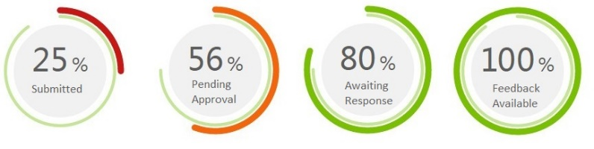




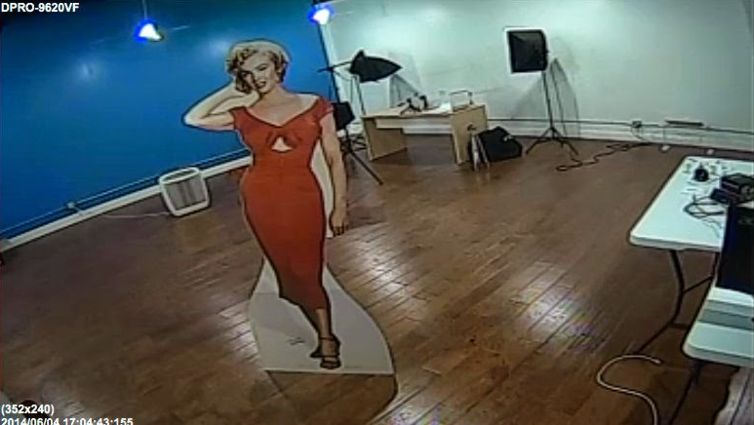
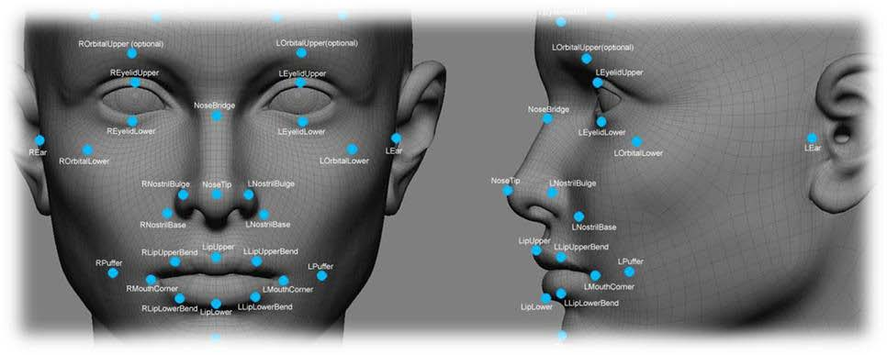
Mobile Prison Officer Concept/Nomis
Staff ideas tracking
The ability for staff to track where in the system their staff idea submissions are and how the process is progressing. The ability for feedback on the suggestions would encourage people to continue to suggest ideas.
Temporary ID Cards
Form time to time the ability for ID cards to be created can be interrupted either by technical difficulties or on occasion they get lost by the prisoner. Due to the demand on reception being high it can be difficult for a prisoner to obtain a new one quickly this then leads to interruption to activities, gym and even healthcare.
The ability to be able to print off a temporary ID card would be a useful tool and could be restricted to a certain number to prevent prisoners becoming dependant on the temporary issue ID card.
Social media pages for public information and events
Other services such as the Ambulance service and South and West Yorkshire police use Facebook and Twitter pages to keep the public informed of local issues and events. The prison service is a closed environment where we try to promote family ties but this can be difficult in such an environment. I would suggest a similar page to be set up where the Governor would be able to post letting families know of events such as family days and during large media covered events such a riots a reassurance to families could be posted to let them know their loved ones are safe and sound. It may also assist in families seeing that we are a caring environment and family orientated “hearts and minds”.
Remote viewing
The ability for a device to be remotely activated whilst in I situation where a member of staff is in danger, for instance a hostage situation. The device could remain active with no indication of a recording taking place. So while the prisoners are trying to activate and use the device it would be recording sight and sound without them knowing.
Facial Recognition
Most officers have experienced a situation where they have asked a prisoner doing something they shouldn’t be what their name and number is and have been denied this information. The facial recognition ability would take away this doubt of identity and empower the officer to go about their duties unrestricted and maintain order and discipline.
TEMP ISS 01 28/03/17

Slide 10


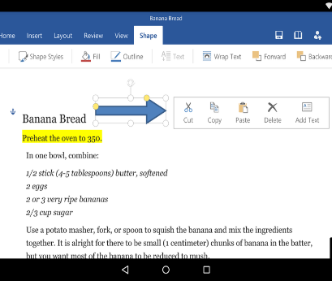
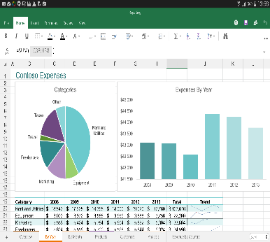





Mobile Prison Officer Concept/Nomis
Upcoming events and Facilities
While on duty officers are routinely asked what family events are coming up and what other events are on the horizon as opportunities to them, likewise there a many events for staff that they are unaware of. If there was a dedicated calendar for these events with relevant filters for staff and prisoners then the uncertainty would be taken away prisoners would be better informed and staff would be able to engage with the events available to them on a more regular basis.
Sharable tasks for manages to send to Staff
A manager could have the ability to send tasks to individual staff or staff in a certain area. This would have a two fold effect. Firstly It would decrease the amount of global emails sent that many people have stopped reading out of the habit that its probably not for them, and secondly it would give managers the ability to effectively track the tasks they send and get feedback confirming it is complete.
Portable Microsoft Office
Most new devices have the ability to effectively run Microsoft office mobile Word and Excel, although these versions have somewhat reduced functionality in comparison to their desktop counterparts they are still capable of conducting tasks that the majority of prison officers or managers would need. The ability to use spreadsheets or read documents and amend them on go would be a practical addition to the tools prison staff need.
Wireless accessories or dockable stations
Wireless accessories and docking stations are mainstream in many businesses and with good reason, the ability to turn your portable device into a functional workstation is priceless. It would reduce the demand on Desktop terminals and allow staff to write reports and conduct day to day prison life while on the move. I believe this would increase productivity by allowing staff the freedom to work anywhere they are without having to search for a free terminal.
Digital assistant (Google now, Siri or Cortana)
The majority of mobile devices now have digital assistants some better than others but all now available cross platform with the exception of Siri. These assistants can be useful in a number of circumstances and could be put to use on the wing and in the office. They make a range of information easily accessible by just asking a question, for instance if a prisoner has a visitor coming to see him then they may need to know which bus route to take and times for that bus and an officer would be able to give his that information quickly and easily using a digital assistant.

Slide 11

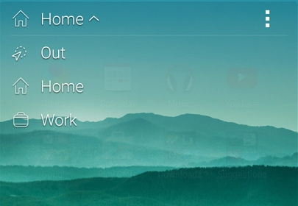

Mobile Prison Officer Concept/Nomis
Finger Print Identification
Nomis has the ability to use fingerprint scans but at present it is not being used, this would be a good addition and would save a lot of time when booking prisoners in and out from reception, it would also be possible to use it on visits to book in and out of the visits hall ensuring the right prisoner is attending or being booked out of reception. This would increase the security of any establishment.
The ability to change the apps available based on location i.e. staff rooms or non prisoner contact areas
Some mobile phone ROMS have the ability built in to arrange applications based on the users location i.e. Home, Work or in the car. Using this principle you could give staff different access options at different times of day based on their locations. A member of staff for instance could be given access to a wider range of applications when in an office, rest room or in a non prisoner facing environment with greater access than when on a wing or on association.
Schedule discharge locations
While using Nomis for induction, reception and Offender management work a user will use the Schedule Enquiry screen quite frequently. This screen contains much of the data required to conduct day to day tasks however there is an important bit of information missing that most officers spend the next 10 minutes collating once they have printed off this screen, This is the prisoners location, in reception officers need it to take the prisoner to reception, induction need it to plan for new receptions and cell availability and OMU staff need it to go and see the prisoner prior to discharge.
Refresh option on Nomis
One of the options missing from Nomis is the ability for a user to easily refresh a screen they are viewing without having to leave that screen and reload it. This applies to numerous screens two examples of this would be Prison roll enquiry and Schedule Enquiry. Adding this feature would save many click of the mouse and lots of lost seconds leaving the screen you want to go back into it again.

